Slide 1
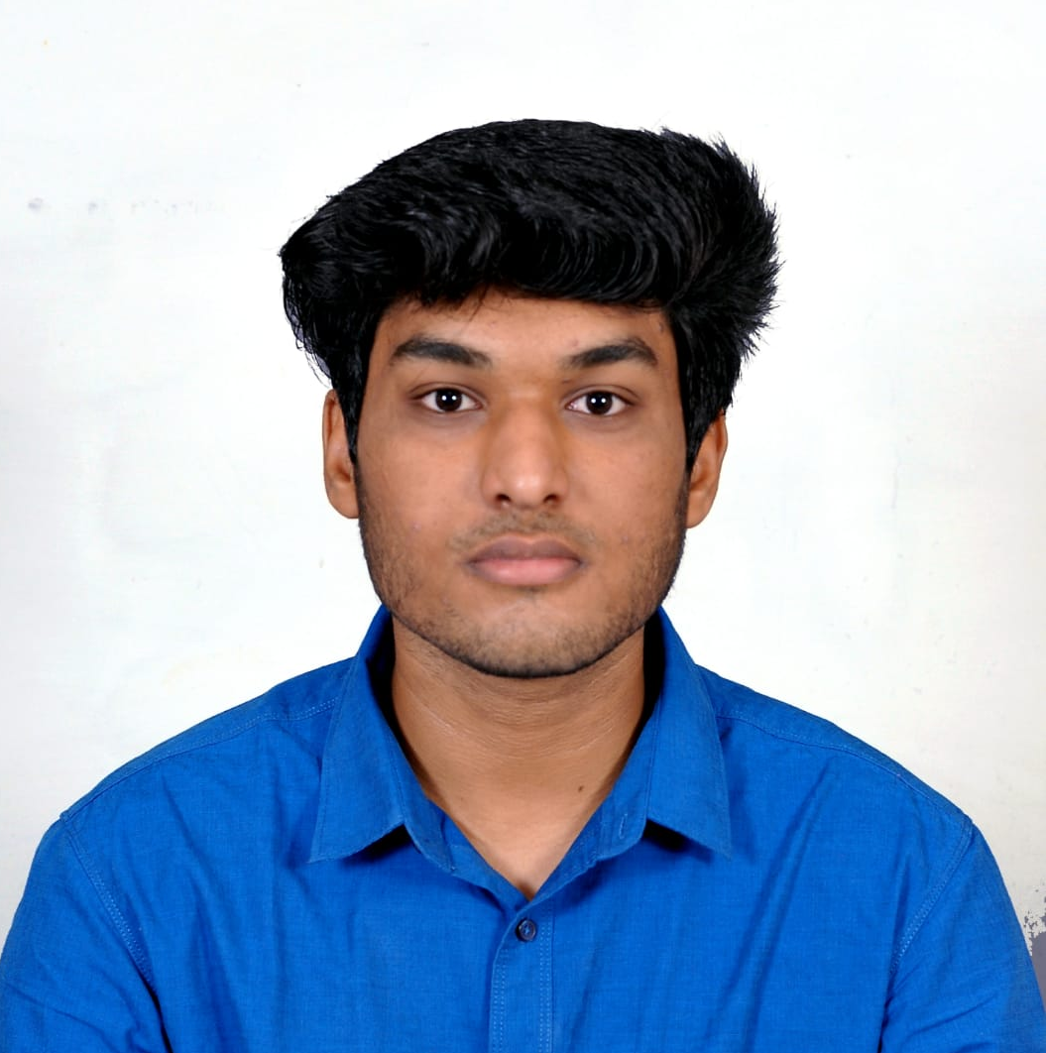

Ajay Krishna J
Analyst/Software Engineer
Bachelor of Technology
Mechanical Engineering: 2018 - 2022
Skills
Mumbai
Java 8 /J2EE | Java Basics, OOPS, Collections, Arrays, Stream API, Junit
Spring core | Dependency Injection, Autowire
Spring REST | REST controllers, Implementation of GET, POST, PUT & DELETE, Bean Validation & Exception Handling, Testing Services, Controller & Repository layer
Spring Data JPA | Implement DAO layer using spring Data repositories
Spring Boot Microservices | Spring Boot Starters, Annotations, Swagger API documentation
Spring Cloud | Eureka, API Gateway
Angular | Components, Services, Modules, Routing & Forms
Database | MongoDB, PostgreSQL
UI | HTML 5 & CSS 3,JavaScript
Tools | Git, Postman
Devops | Jenkins, Docker
Add On skills | Self-motivated, Flexible, Communication
ajay.krishna-j@capgemini.com
+91 9629084121
A4
Full Stack Developer
Hands-on experience in building Java Microservices with Spring Boot, Spring Security, Spring Cloud API Gateway, Eureka Server, Gradle/Maven, including logging with SLF4J, and MongoDB, PostgreSQL as back-end.
Experience in creating documentation with Swagger and in unit testing using Junit, Mockito and creating tasks in Jenkins.
Hands-on experience in developing web pages using HTML5, CSS3, and Angular.
Development experience in creating docker images and pushing to Docker Hub.
Hands-on deploying Spring Boot applications in AWS EC2 instances as Docker containers using S3 buckets.
Online Hotel Management Application
Completed end-to-end case study of Online Hotel Management Application along with JWT authentication, Swagger and payment gateway using Paytm, Angular used for user interface.
This application helps in the management of guests, staffs, rooms, reservations and inventories.
Crop Bidding Application
Completed end-to-end case study of Crop Bidding Application and deployed it in AWS EC2.
This application is to help the farmers sell their crops in auctions.

